Slide 1
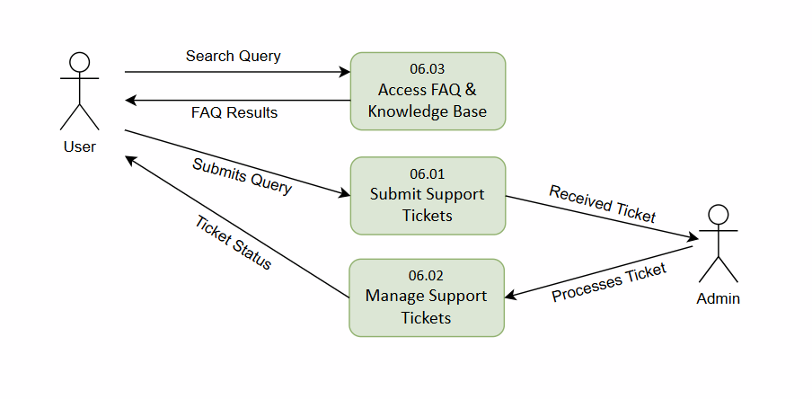
Hearts & Paws​
Data Flow Diagram (Logical) – Customer Support and Compliance

Slide 2
Hearts & Paws​
Data Flow Diagram (Physical) – Customer Support and Compliance
D2 – FAQ
FAQ API/ Controller
D3 – Support_Tickets
Backend Ticket API / Service

